Slide 1
Reviewing superhero u ad campaigns

Slide 2


OUR Team
Abduhu Khan – Team Lead
Mohd Arshad – Project Manager
Prajwal Mandale – Project Manager
Rohit Galande – Project Lead

Slide 3
Superhero u event
Superhero U is an event that encourages participants to explore their superpowers and think outside the box to address real world challenges.
The event focuses on inspiring creativity and innovation within a community of young problem solvers.
The mission is to create, innovate and do problem solving.

Slide 4
GOALS OF SUPERHERO U EVENT
SuperHero U Event
People
Peace
Planet
Partnerships
Prosperity

Slide 5


Facebook ads
Target Specific Demographics and Interests
Multiple Ad Formats: Images, Videos, Slideshows
Real-Time Performance Analytics
Cost-Effective Advertising Options
Boost Brand Awareness and Sales
Drive Traffic to Your Website

Slide 6
Superhero u ad campaigns
There are 11 campaigns that are being run in the Superhero U ad campaigns.
Campaign 1 is aimed for the audience belonging to educators and principals.
Campaigns 2-11 are aimed for a targeted audience of students.
Each campaign is linked to a different geography.

Slide 7
METRICS OF ADS
Reach
Impressions
Frequency
CTR
CPC
CPR

Slide 8
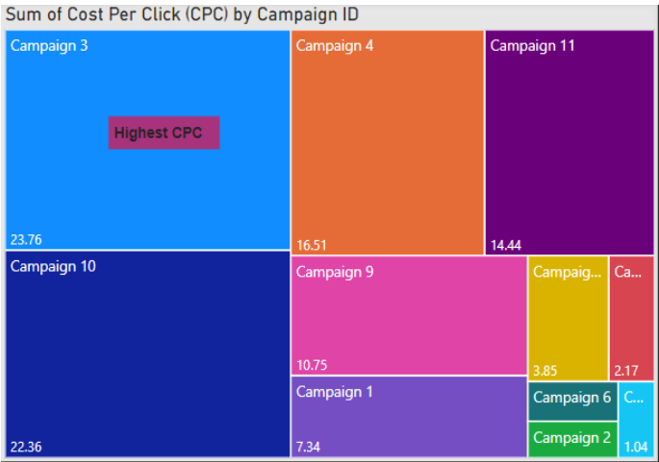
DATA VISUALS
Tree visual depicting cost per click by campaign ID.
Campaign 3 has the highest CPC.
Campaign 8 has the lowest CPC.
CPC of campaign ∝ 1/Effectiveness of campaign

Slide 9
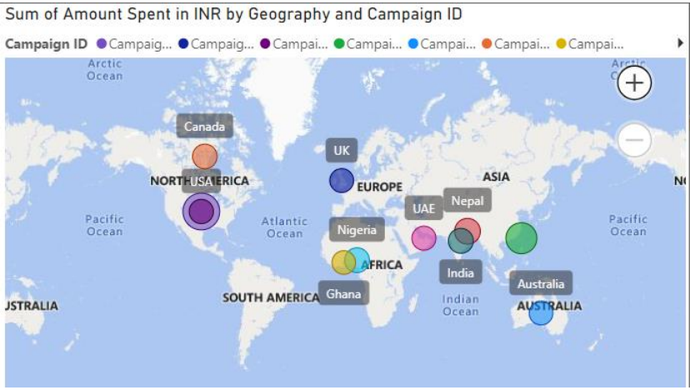
DATA VISUALS
Map depicting sum of amount spent by geography and Campaign ID.
Cost spent on each campaign is depicted by the bubbles.
Size of bubble ∝ Amount spent by campaign in that area.
Highest amount spent in the North American region shown by purple bubble.

Slide 10
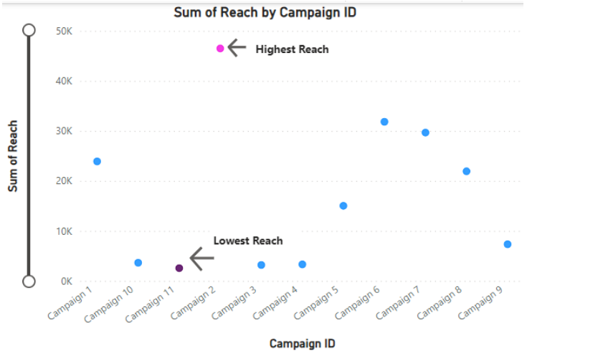
DATA VISUALS
Scatter plot showing the reach of each campaign.
Reach ∝ Effectiveness of Campaign.
Campaign 2 has the highest reach.
Campaign 11 has the lowest reach.

Slide 11
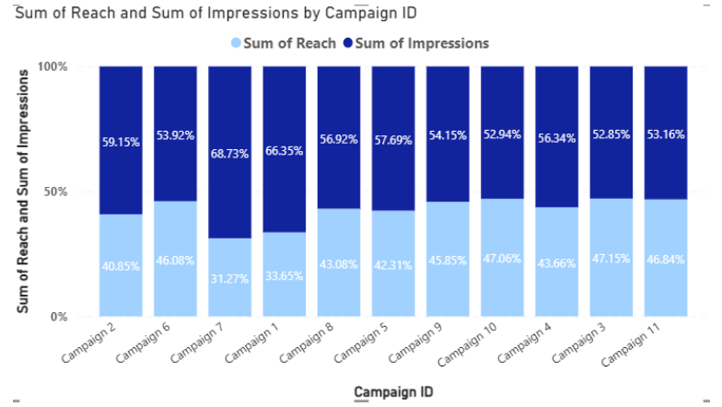
DATA VISUALS
Stacked column chart showing the reach and impressions of each campaign.
Reach ∝ Effectiveness of Campaign.
Impressions ∝ Effectiveness of Campaign.

Slide 12
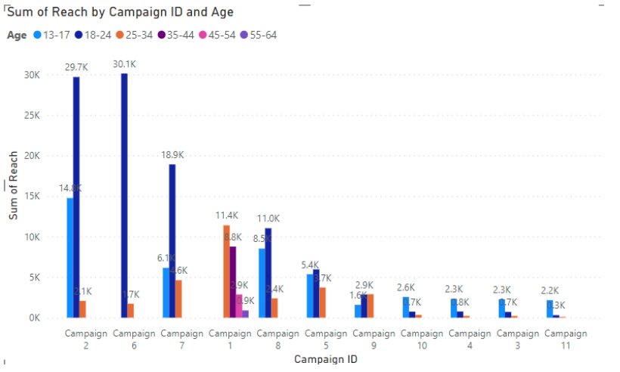
DATA VISUALS
Campaign 2 has the highest reach for the students aged between 18-24.
Campaign 3 has lowest reach for almost all groups of ages.

Slide 13
DISCONTINUATION OF CAMPAIGN
Campaign 3 shall be discontinued among all the campaigns based on the metrics such as Cost per Click (CPC), Cost per Result (CPR), Click through Rate (CTR) and Reach.
Campaign 3 has the highest CPC. (bad indicator)
Campaign 3 has the highest CPR. (bad indicator)
Campaign 3 has less than average value of CTR. (bad indicator)
Campaign 3 has the lowest reach and impressions as compared to other campaigns. (bad indicator)

Slide 14
CONCLUSION
Campaign 3 did not prove to be effective in terms of cost and reach etc as depicted by the data visualizations. Therefore, out of all the campaigns from 1 to 11, it is concluded that Campaign 3 should be discontinued.

Slide 15


